Slide 1
Amazon CloudFront
Amazon CloudFront is a web service for content delivery. It integrates with other Amazon Web Services to give developers and businesses an easy way to distribute content to the clients or end users with low latency, high data transfer speeds, and no commitments.
Amazon CloudFront can be used to deliver your entire website, including dynamic, static and streaming content using a global network of edge locations. Requests for objects are automatically routed to the nearest edge location, so content is delivered with the best possible performance.
There are no contracts or monthly commitments for using Amazon CloudFront—you pay only for as much or as little content as you actually deliver through the service.

Slide 2
Amazon Cloud-front
Amazon CloudFront is optimized to work with other Amazon Web Services, like Amazon S3 and Amazon EC2.
It is a Cloud-based content distributing network enables you to place the content at the edges of the network for rapid delivery.
It Places the contents in S3 and run the application from anywhere and the content is moved to where the application is (to the edges).

Slide 3
Amazon CloudFront
CloudFront is a web service that speeds up distribution of static and dynamic web content, for example, .html, .css, .php, and image files, to end users.
CloudFront delivers the content through a worldwide network of data centers called edge locations.
When a user requests content, the user is routed to the edge location that provides the lowest latency (time delay), so content is delivered with the best possible performance.
If the content is already in edge location, CloudFront delivers it immediately.
If the content is not currently in that edge location, CloudFront retrieves it from an Amazon S3 bucket that is identified as the source for the definitive version of the content.

Slide 4
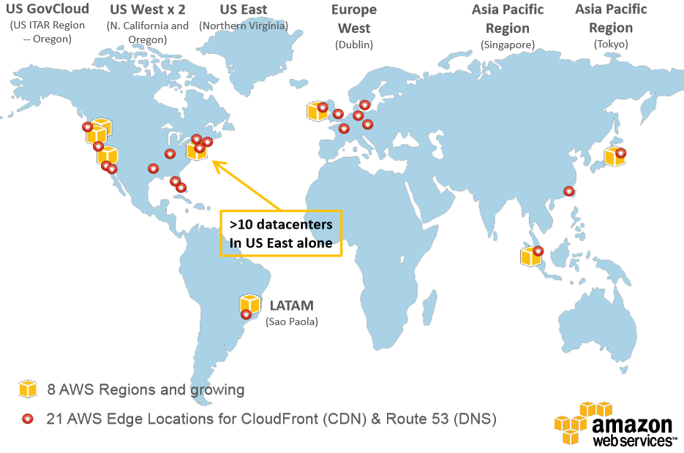
AWS Data Centers in 8 Regions and Edge Locations

